Slide 1
Infinity Cafe’s
Infinite-Data System
Team 1
Notes:
Welcome to Team 1’s Final Project presentation

Slide 2
Infinity Cafe: Background
The Infinity Cafe franchise has dozens of cafes throughout the UK
Franchise owners may independently manage multiple cafes
Franchise owners cannot easily share information
Jack
Notes:
5 weeks ago, Infinity Cafe approached us and asked us how we could help transform the way they capture and retrieve insights from their data. They wanted a modern, robust data pipeline that would help them make data-driven decisions, identifying opportunities to provide a better service.
Bit of background:
Further points for each bullet
[2] - Each with varying menus and opening hours
[3] - They cannot share their successes, and neither their failures. Making them liable to repeating mistakes and overlooking solutions that might have been implemented by other cafes.

Slide 3

Infinity Cafe: Your current data strategy
Sales figures for each cafe are downloaded monthly
Head Office might look at the figures
Misspelled and missing data in the figures made it difficult to analyse effectively
?
Jack
Notes:
[all] These 3 points combined made it difficult to identify trends and respond to changes in customer behaviour.
Therefore impeding you from delivering the best service to those customers.

Slide 4
Transforming Infinity Cafe: A New Data Strategy
How can our cafes start sharing data?
Sales figures and purchasing trends
Tales of successes / challenges overcome
Who are our customers?
Identify their needs
How can we harness this data to transform our service?
Changing menus per customer needs
Amend opening hours to adapt to demand.
Many more!
Jack
Notes:
“After identifying these drawbacks in the current process, it was apparent that a change was needed.
The new data strategy will help us understand:

Slide 5
Infinite-Data System: Key Features
Uses daily figures, not monthly up-to-date customer insights
Securely hosted in the cloud accessible anywhere
Data visualisation easily digestible overview
Automated pipeline focus on decision-making &
identifying opportunities
Yousef
Notes:
Elevator Pitch:
For Franchise managers and head office data analysts, who want to understand sales trends of a single cafe over a day, the Infinite-Data System is a data pipeline that takes data from a CSV store in the cloud and displays it in a graph unlike the existing local data system, our product will display data the following day rather than a month later.

Slide 6
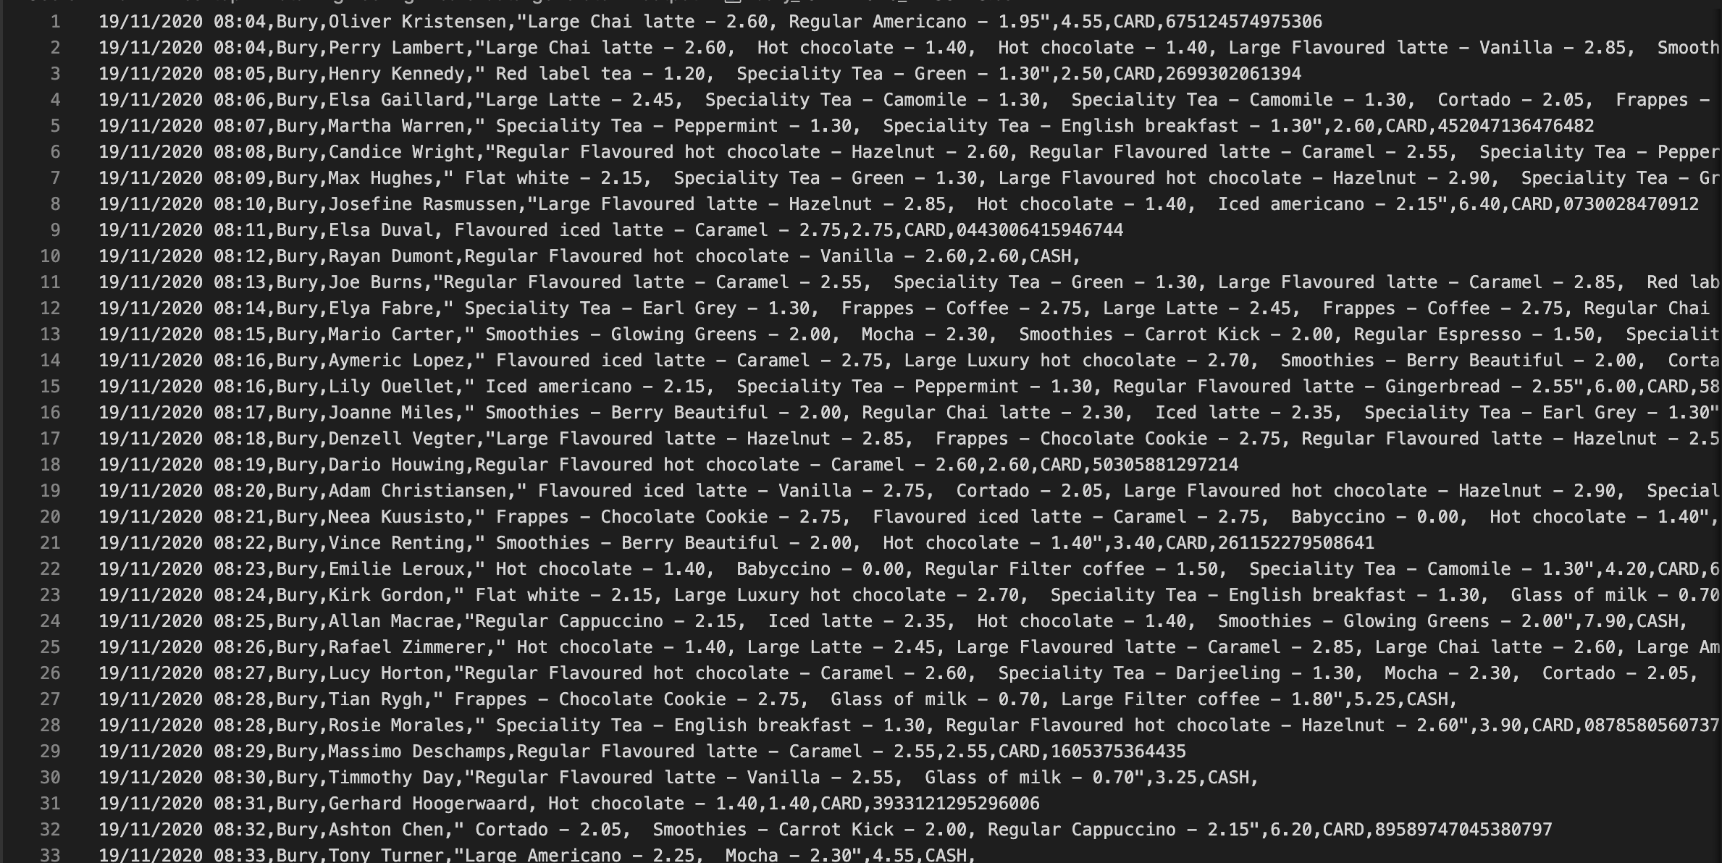
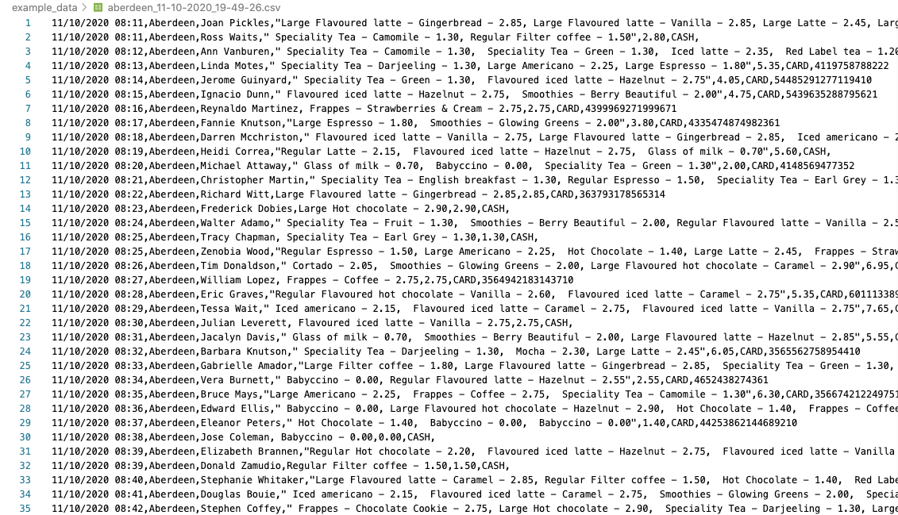
Infinite-Data System: Overview in Graphics
Input : CSV FILE
Johnny

Slide 7
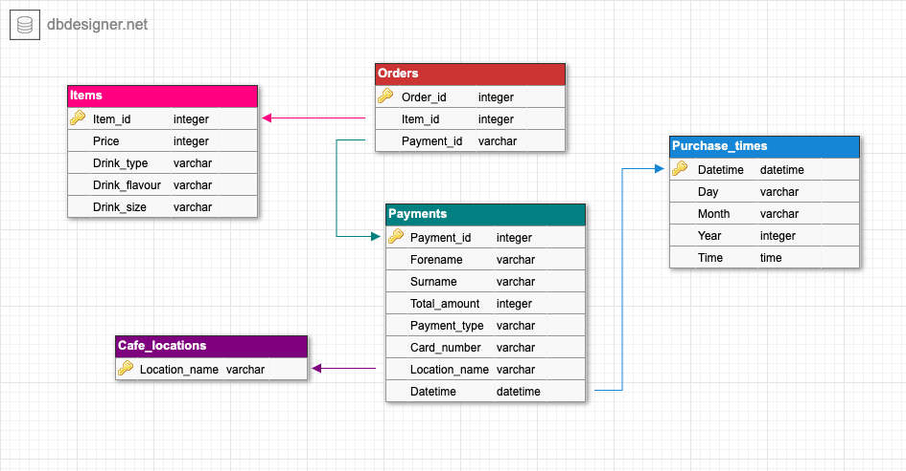
Infinite-Data System: Overview in Graphics
Output: Database schema
Johnny

Slide 8
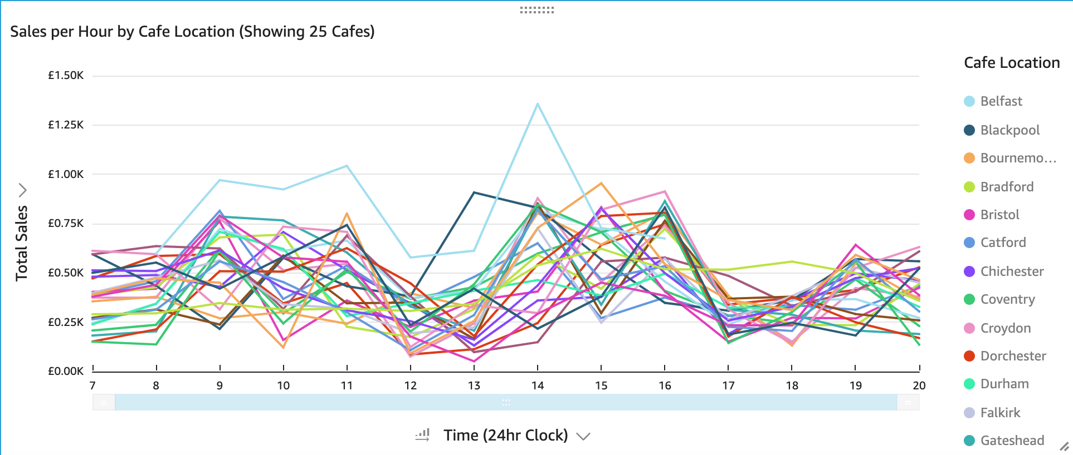
Infinite-Data System: Overview in Graphics
Johnny

Slide 9
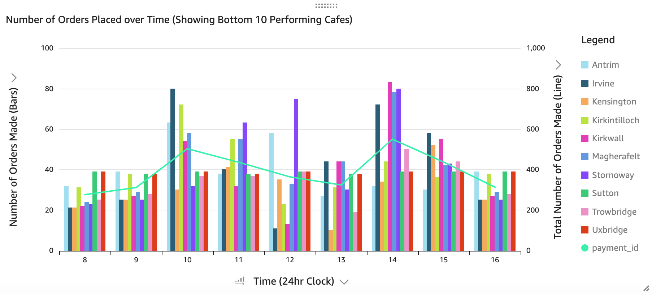
Infinite-Data System: Overview in Graphics
Johnny

Slide 10
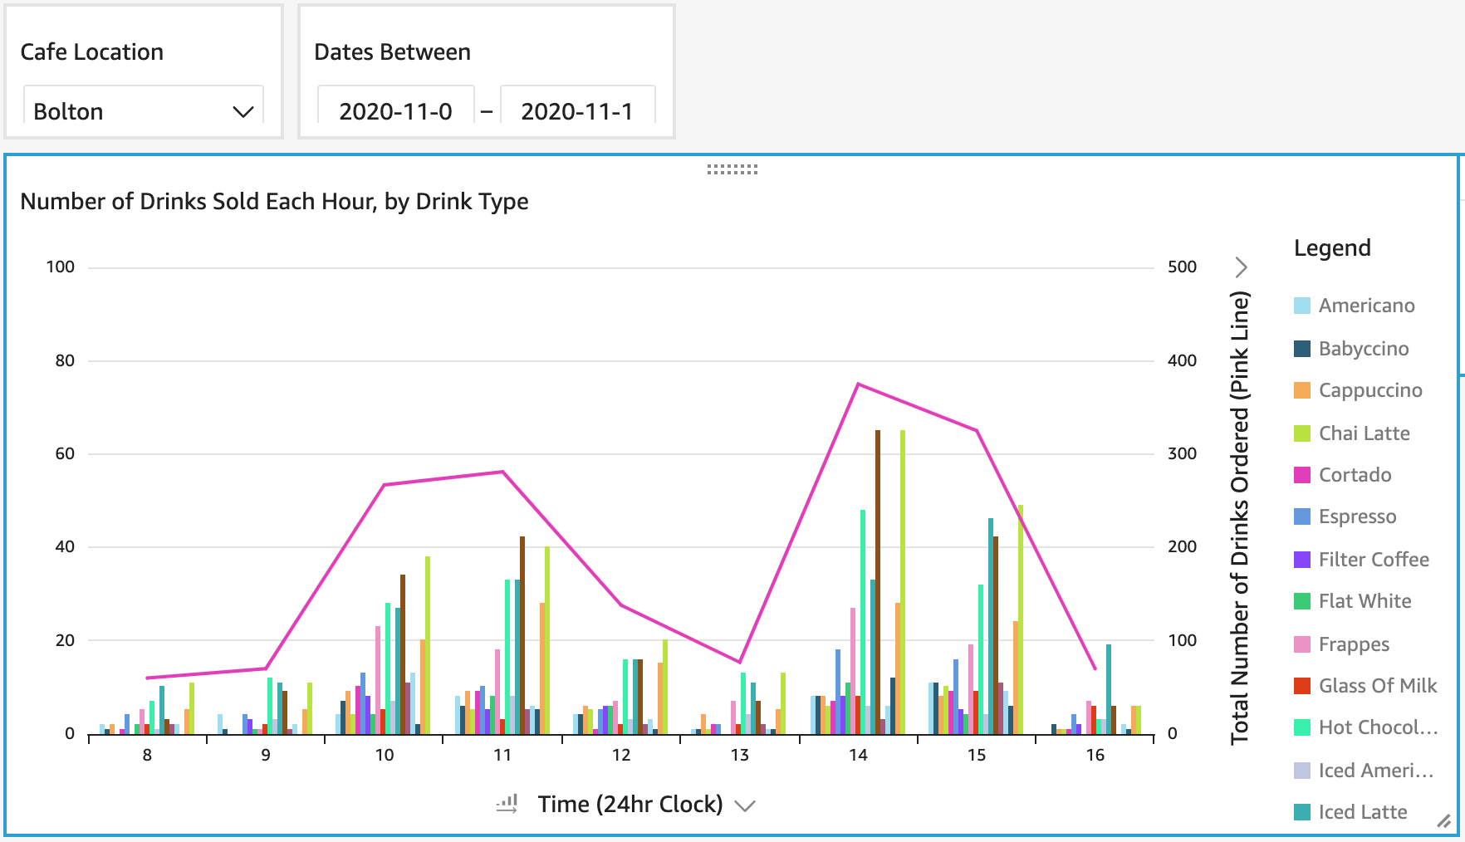
Infinite-Data System: Overview in Graphics
Johnny

Slide 11
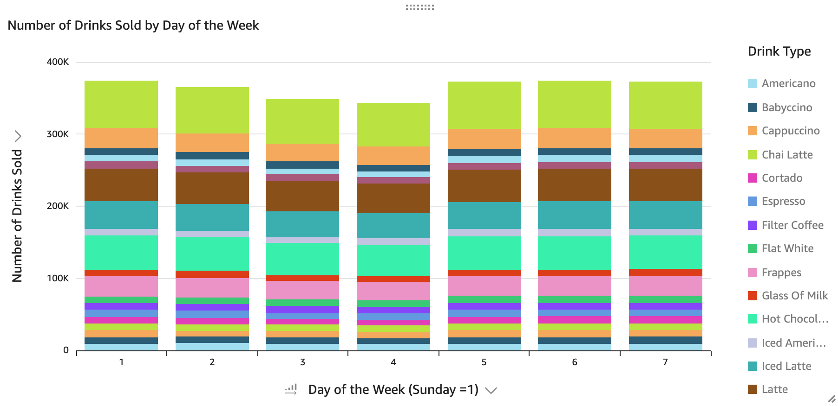
Infinite-Data System: Overview in Graphics
Johnny

Slide 12
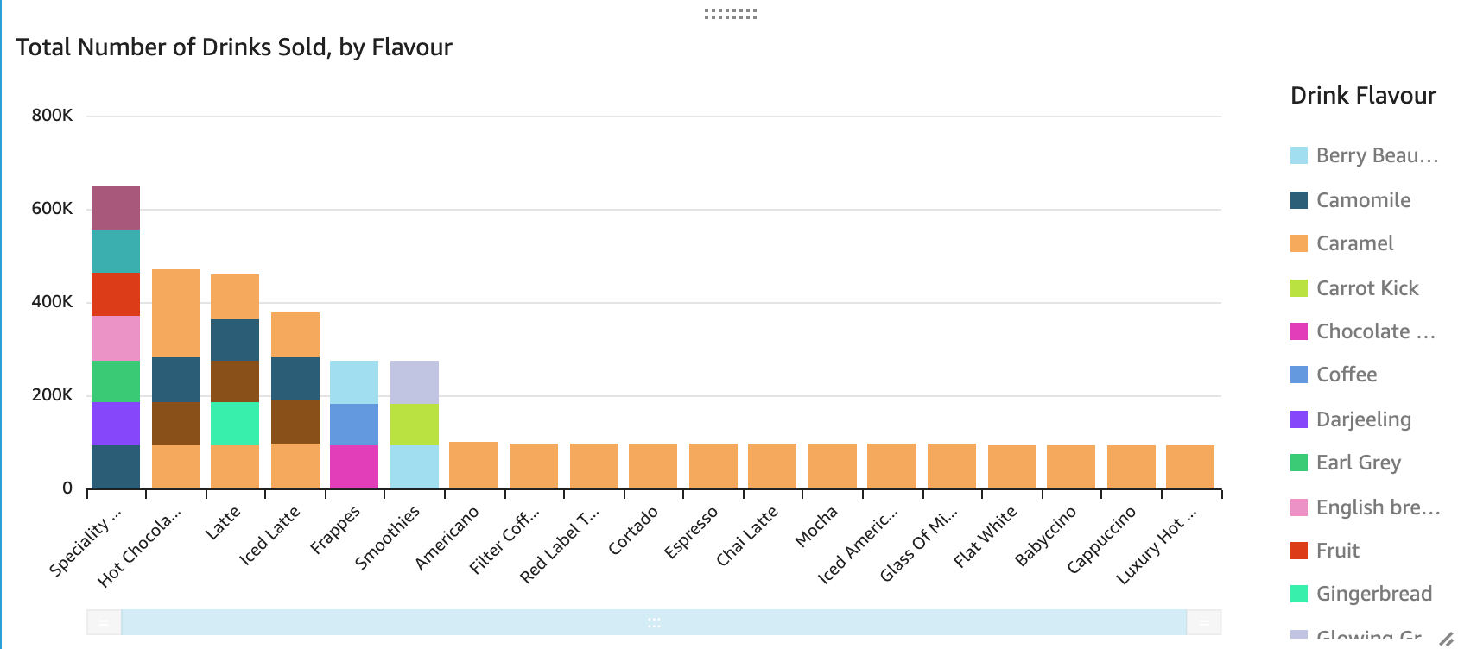
Infinite-Data System: Overview in Graphics
Johnny

Slide 13
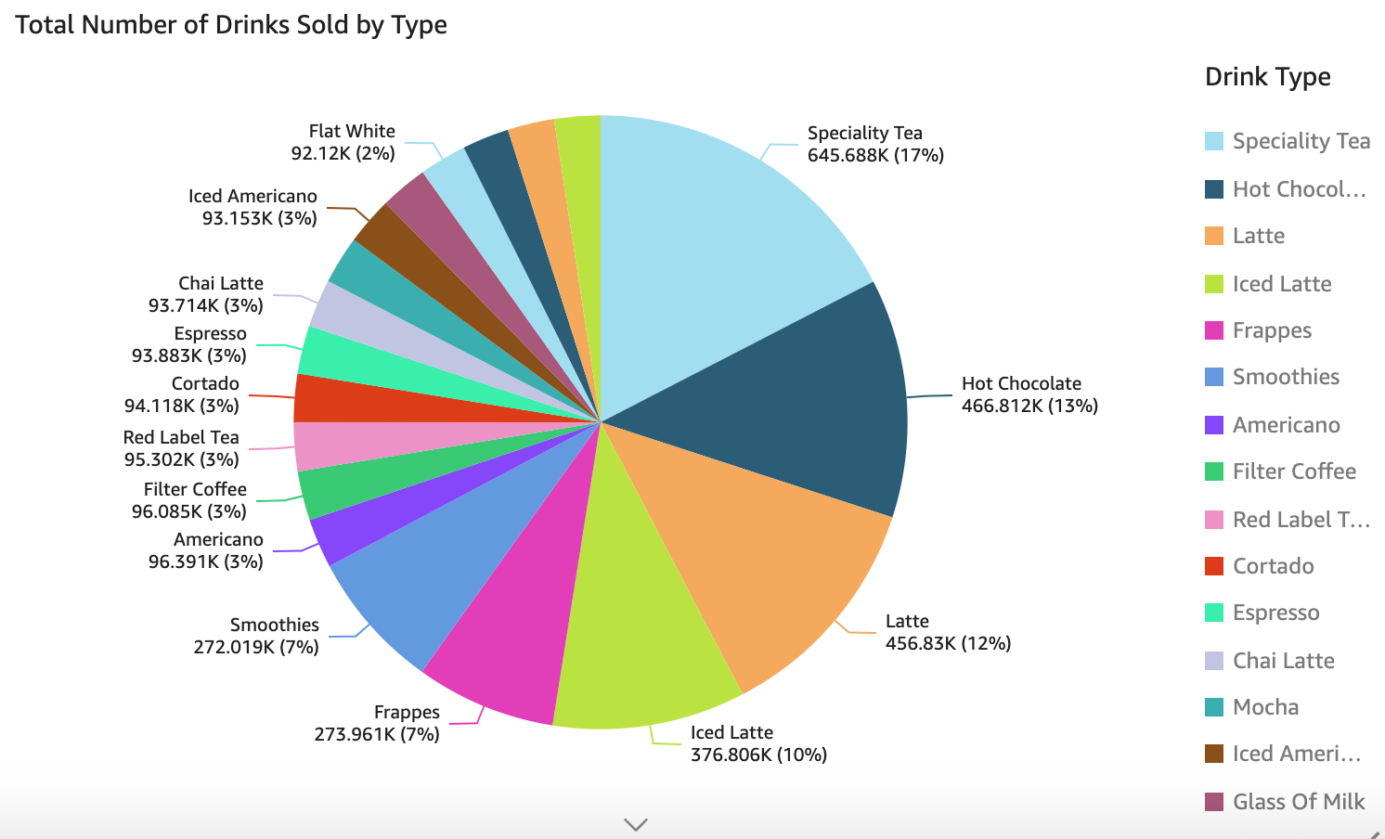
Infinite-Data System: Overview in Graphics
Johnny

Slide 14
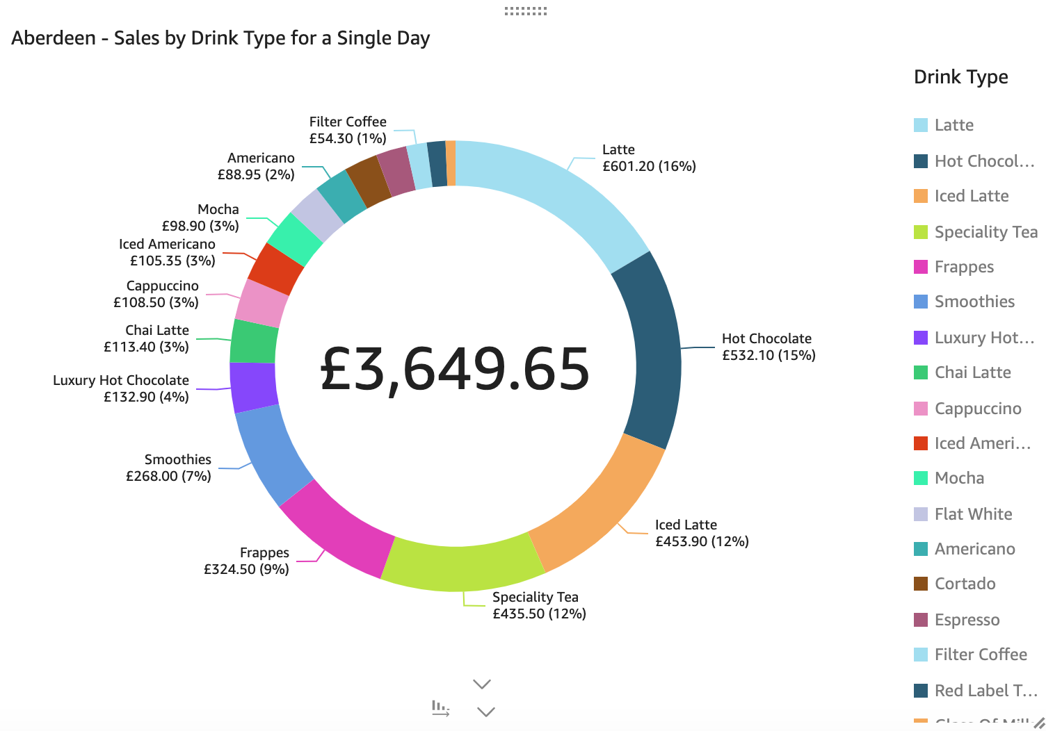
Infinite-Data System: Overview in Graphics
Johnny

Slide 15
ETL: Pipeline
Yogini

Slide 16
ETL: Pipeline
Yogini

Slide 17
ETL: Pipeline
Yogini

Slide 18
ETL: Pipeline
Yogini

Slide 19
ETL: Pipeline
Yogini

Slide 20
ETL: Pipeline
Yogini

Slide 21
ETL: Pipeline
Yogini

Slide 22
Infinite-Data System
Data pipeline demo
Mat

Slide 23
Final Project (behind the scenes)
Actually making the thing...

Slide 24
Technologies Used
How these benefitted us, and helped us deliver the product.
GitHub - source control
AWS - S3, Lambda, Redshift
AWS Cloudformation / Serverless Framework (IaC)
GitHub Actions (CI / CD)
Matt
Notes:
The technologies you used, what the benefits of these are and the extent to which they fit the solution

Slide 25
The challenges you faced
Being cursed
Losing multiple team members to sickness absence
Deciding where you can contribute, especially in the beginning
Realising how large a task is, and distributing workload
Switching local MySQL to the AWS Redshift version of Postgres (which doesn’t use all the functionality of postgresql)
Program efficiency challenges
SQL queries are slowwww
Suman
Notes:
Our team members who were total beginners, including myself, found it challenging to choose tasks because they were sure how they could contribute to the team especially in the beginning and also, as we were working in tandem...

Slide 26
Lessons Learnt
Working as a team → using Github to collaborate effectively
Never push changes on Master branch
Ensuring that other team members are approving any changes we make
Communication skills
Voice chats & Screen-sharing
Pair-programming
AWS Tools
End-to-End Delivery for a data pipeline for the first time
Cleaning Data
The real data pipeline was the friends we made along the way
Suman
Notes:
Suman
Cleaning data to ensuring data is correct, consistent and usable.
Data engineers are responsible for finding trends in data sets and developing algorithms to help make raw data more useful to the enterprise.

Slide 27
If we had more time...
Create some form of structured logging
Alerts/Monitoring
Kinesis Data Streaming
Bug Tracker document
Help aid conversations regarding known bugs, avoiding confusion
More unit testing
Yogini
Notes:
Read from CSVs without significant duplication in Redshift
Data visualisations

Slide 28
Reflections on working together as a team
Agile / Sprints
Split into 3 sprints
GitHub Projects Board
Easily share / assign work to team members
Friendly group, easy to get along with each other
Victor
Notes:
Split the projects into 3 Sprints to make the work easier to tackle
GitHub projects board

Slide 29







Thank you for listening!
Questions?

